Slide 1

FULL STACK DEVELOPMENT- MERN STACK

Slide 2
Agenda
What is FULL stack development?
The scope and future prospects of this technology
Who can learn this?
Any work experience required to take up this skills?
What are the job prospects after doing this course?
Job prospects for freshers?

Slide 3
FULL Stack Application Development is witnessing a growing trend in usage.
MEAN is an abbreviation of:
M = MongoDB: nosql Database
E = Express: Back-end web framework
A /R= Angular/React : Robust framework for developing HTML5,CSS and JavaScript, Bootstrap- web programs
N = Node.js: a server-side JavaScript run time environment

Slide 4
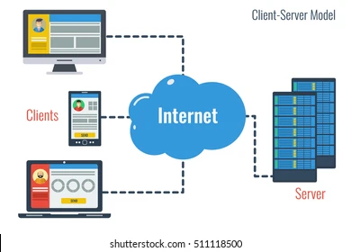
Mobile And Web App Development

Slide 5
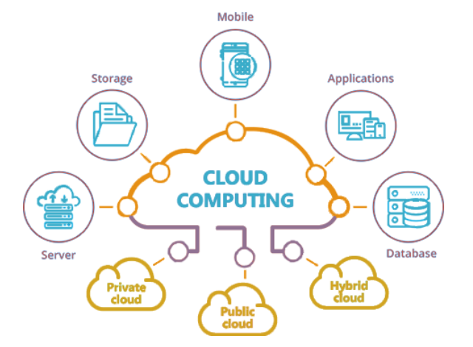
Cloud Computing

Slide 6
Applications
Web Applications | Hybrid Applications | Native Applications
Web apps are responsive websites that are dependent on browsers, not operating systems. HTML5 is generally used to build such applications. | Hybrid apps are created to work on more than one operating system or platform. Hybrid apps are built using a combination of HTML5 and languages like Java. | Native apps are developed to work on one operating system. Native apps are built using Java, Swift, Objective-C.

Slide 7
Front End
Known as the client-side
Comprises everything a user sees or interacts with, such as the user interface and graphical elements—through a combination of design, technology, and programming
Frontend developers help ensure that users can easily interact with the page.

Slide 8
Essential Frontend Development Skills
HTML
CSS
Javascript
ReactJS/AngularJS/VueJS
AJAX
jQuery
Bootstrap

Slide 9
Back End
It is often referred to as the server-side and comprises all the behind-the-scenes elements needed to power a website or application
Such as databases, APIs, backend logic, and servers

Slide 10
Essential Backend Development Skills
Node.js
Express
MongoDB

Slide 11
Backend frameworks
Python-Django ,Flask,Odoo Development
PHP-Laravel , CodeIgniter
GO-Echo
Ruby-Ruby on Rails

Slide 12
DataBases
Two types of Databases:SQL and NoSQL
SQL Databases
MySQL
SQLite
Oracle DB
PostgreSQL
MS SQL

Slide 13
NoSQL DataBases
MongoDB
Redis

Slide 14
Full stack development
A full stack developer, then, is someone who can do both types of web development. They have a wide variety of skills that enable them to build, manage, and improve server-side operating systems, databases, libraries, and frameworks, while also understanding the UX design needs of a web or mobile application.

Slide 15
Different Fullstack development Technologies
MEAN Stack Development
M:MongoDB, E:Express, A:AngularJS, N:Node.JS
MERN Stack Development
M:MongoDB, E:Express, R:ReactJS,N:Node.JS

Slide 16
MEA(R)N is a free and open-source JavaScript software stack for building dynamic websites and web applications
MEA(R)N is an acronym for MongoDB,ExpressJS, Angular/React.js, and Node.js. From client to server to database, MEA(R)N is full stack JavaScript.

Slide 17
MEA(R)N stack Architecture

Slide 18
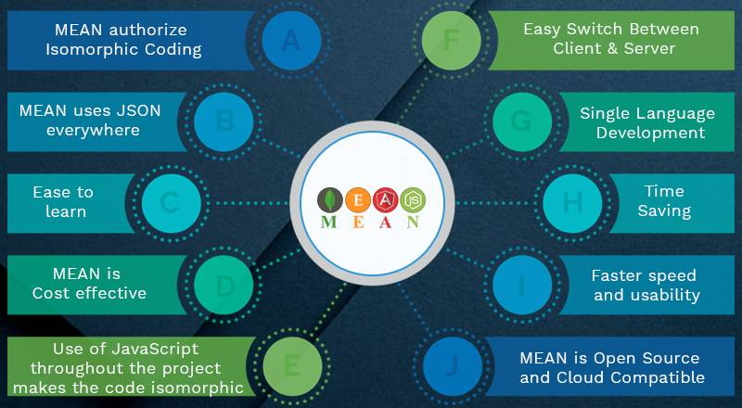
Benefits Of Full Stack Developer

Slide 19
Projects

Slide 20
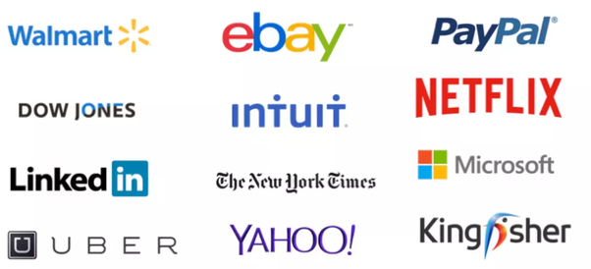
WORLD’S GIANT AND RENOWNED ORGANIZATIONS ARE USING MEAN STACK TO CARRY OUT A SMOOTHER EXPERIENCE.

Slide 21
FULL Stack Role in Industry

Slide 22
Healthcare
Finance
Technology
Retail
Marketing
Online communities
IOT Application Development with Mean Stack

Slide 23
Mea®n Stack Features

Slide 24
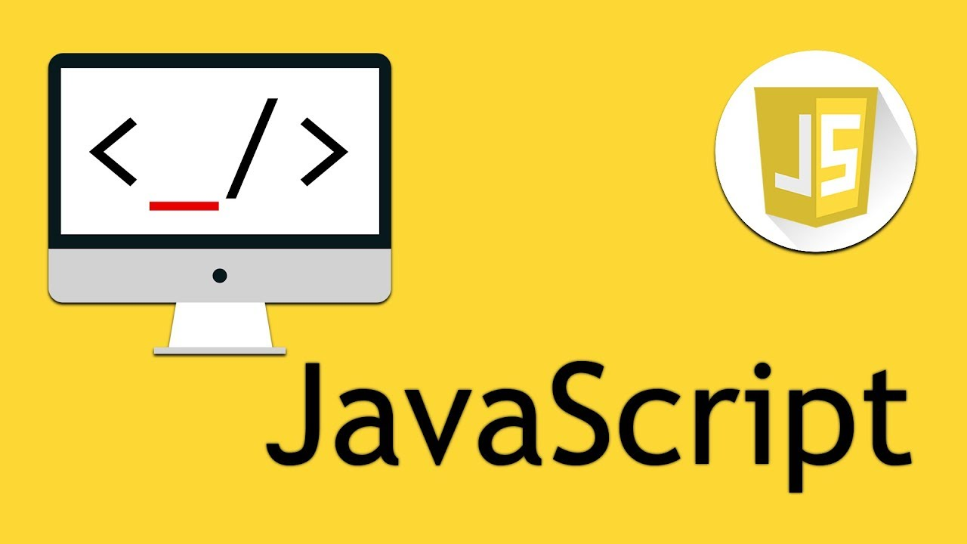
Build with JavaScript

Slide 25

1. The language of JSON

Slide 26
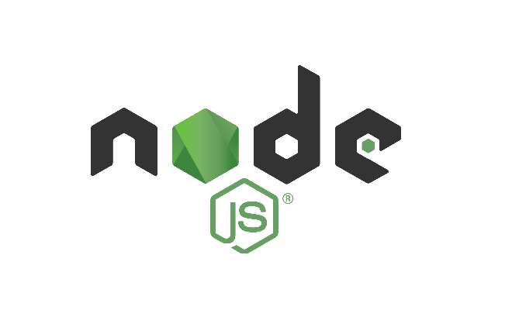
2 .Node.js

Slide 27

3. Angular

Slide 28

3. React

Slide 29

4. MongoDB

Slide 30
What is Angular
Complete framework for web applications.
Use of TypeScript.

Slide 31
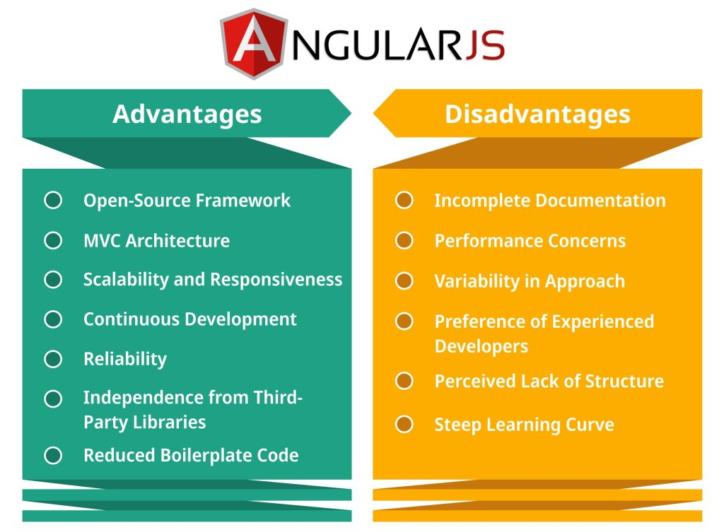

Slide 32
Angular's Key Features
Two-way data binding.
Dependency injection.
Component-based architecture.
Routing and navigation.
Form handling.
Official CLI for scaffolding.

Slide 33
Angular's Ecosystem
Angular Material for UI components.
NgRx for state management.

Slide 34
What is React?
JavaScript library for user interfaces.
Virtual DOM.

Slide 35
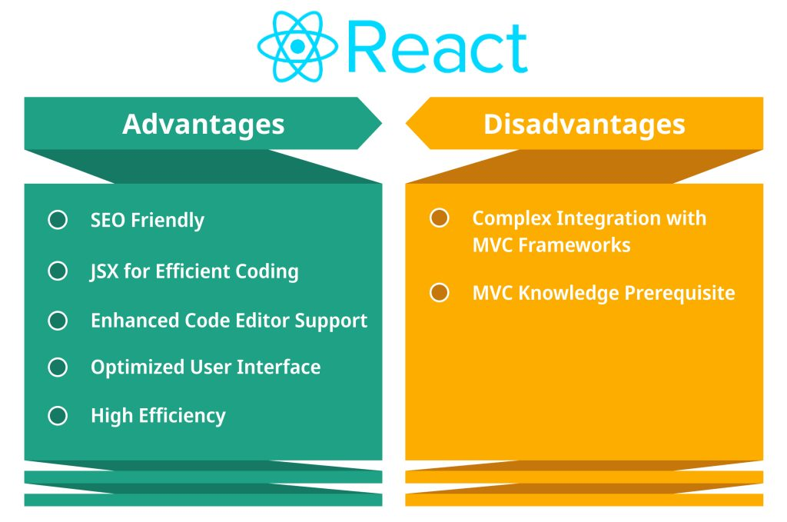

Slide 36
React's Key Features
Component-based architecture.
Virtual DOM.
JSX (JavaScript XML).
Unidirectional data flow.
Strong community support.

Slide 37
React's Ecosystem
Redux for state management.
Popular UI libraries like Material-UI.

Slide 38
FEATURE | ANGULAR | REACTJS
Category | Full-fledged framework | Javascript library
Learning Curve | Steeper | Moderate
Architecture | MVC(Model-view-Controller) | Component -based
Data Binding | Two-way | One-way
Suitability | Complex SPAs,Enterprise Applications | Interactive UIs, Dynamic web applications
Community & Support | Large, well-documented | Vast, actively developed
Performance | Potentially faster for complex SPAs | Potentially faster for simpler apps
Focus | Structure, maintainability | Flexibility, rapid development
Key Features | TypeScript, Dependency Injection, Modules, Routing, Services, Directives, Forms | Virtual DOM, Components, JSX

Slide 39
Feature | Angular | ReactJS
Language | Angular is written in Typescript language, which is a superset of ECMAScript 6 (ES6). | JavaScript+JSX
Purpose | Create dynamic web applications. | Create interactive UI components.
Developed By | Google | Meta (known as Facebook earlier)

Slide 40
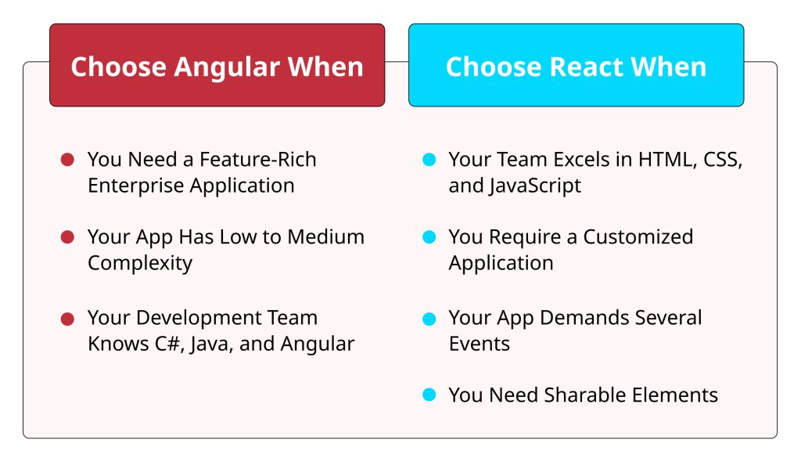

Slide 41
ADVANTAGES OF MERN STACK DEVELOPMENT

Slide 42

1. It is Cost-Effective

Slide 43

2. High speed and security

Slide 44

3.Free and Open-Source

Slide 45
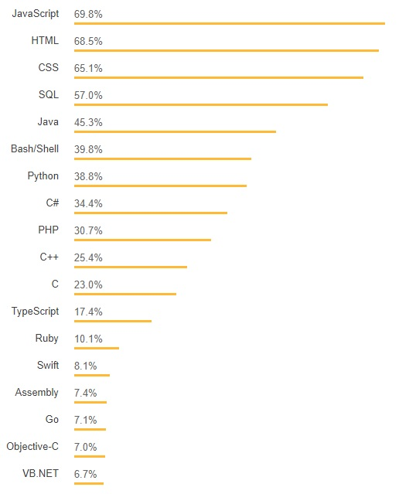
JavaScript-The Most Popular Language

Slide 46
AVERAGE SALARY FOR MERN STACK DEVELOPER

Slide 47
NUMBER OF VACANCIES

Slide 48
Job Profiles
Mea®n Stack Developer
Full Stack Developer
Senior web developer
Application Developer
Mobile-app Developer
React Developer
Angular Developer

Slide 49
Who can learn
Freshers who possess interest in web technologies
Student who want to become the Full Stack Web Developers will find this course very beneficial
Front end Developers who want to learn backend programming
Backend developers who want to learn front end programming

Slide 50
Prerequisites for Mea®n Stack
Javascript
Basic of Front end is required.

Slide 51

Thank you..

Slide 52
PRACTICAL SESSION

Slide 53
The Built-in HTTP Module
Node.js has a built-in module called HTTP, which allows Node.js
to transfer data over the Hyper Text Transfer Protocol (HTTP).
To include the HTTP module, use the require() method:
var http = require('http');

Slide 54
Node.js as a Web Server
The HTTP module can create an HTTP server that listens to server ports and gives a response back to the client.
Use the createServer() method to create an HTTP server:
Example
var http = require('http'); //create a server object: http.createServer(function (req, res) { res.write('Hello World!'); //write a response to the client res.end(); //end the response }).listen(8080); //the server object listens on port 8080

